Slide 1

PostgreSQL Introduction
SoftUni Team
Technical Trainers
Software University
https://softuni.bg

Slide 2
Table of Contents
Data Management
PostgreSQL
Structured Query Language
Data Types
Table Relations
Basic SQL Commands
2
Notes:
2

Slide 3
Have a Question?
sli.do
#python-web
Notes:
3

Slide 4

Data Management
When Do We Need a Database?

Slide 5
Storage vs. Management
SALES RECEIPT
00315 – 07/16/2016
David Rivers
Oil Pump (OP147-0623)
1 x 69.90
Date: 07/16/2016
Order#:[00315]
Customer: David Rivers
Product: Oil Pump
S/N: OP147-0623
Unit Price: 69.90
Qty: 1
Total: 69.90

Slide 6
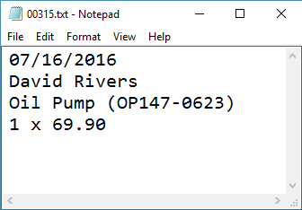
Storage vs. Management (2)
Order# | Date | Customer | Product | S/N | Qty
00315 | 07/16/2016 | David Rivers | Oil Pump | OP147-063 | 1

Slide 7
Database
A database is an organized collection of related information
The user doesn't have direct access to the stored data
Access to data is usually provided by a DBMS
7
Notes:
Show how it looks one database file

Slide 8
Database Table Elements
The table is the main building block of any database
Each row is called a record or entity
Columns (fields) define the type of data they contain
Column
CustomerID | FirstName | Birthdate | CityID
1 | Brigitte | 03/12/1975 | 101
2 | August | 27/05/1968 | 102
3 | Benjamin | 15/10/1988 | 103
4 | Denis | 07/01/1993 | 104
Row
Cell
Notes:
The table is the main unit of data storage. It has rows, columns and cells. Cells contain stored data. Each column has a data type. Types can be VARCHAR(String), INT, DATE etc.

Slide 9
Data Base Management System
Data Base Management System
Provides tools to define, manipulate, retrieve and manage data in a database
Parses requests from the user and takes the appropriate action
9
Notes:
Show how it looks one database file

Slide 10



Database Engine Flow
Clients
Query
Engine
Access
Database
Data
Data

Slide 11

PostgreSQL

Slide 12
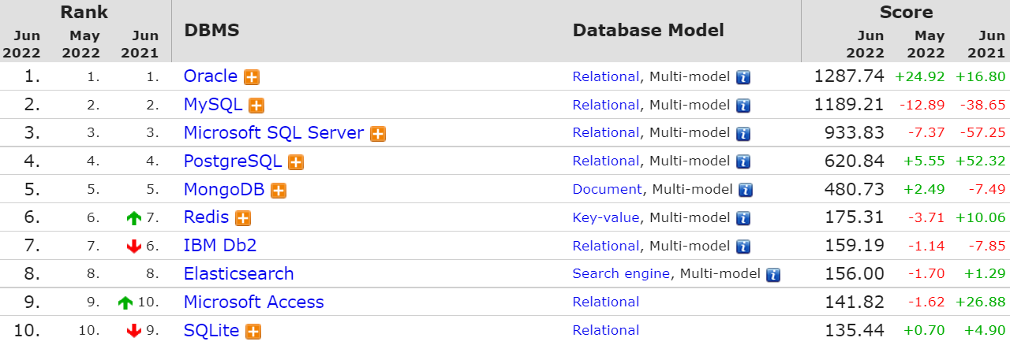
What is PostgreSQL?
Object–Relational Database Management System (ORDBMS)
Widely used open-source cross-platform system

Slide 13
What makes PostgreSQL stand out?
First DBMS that implements multi-version concurrency control feature
Able to add custom functions
Designed to be extensible
Defining custom data types, plugins, etc.
Very active community

Slide 14
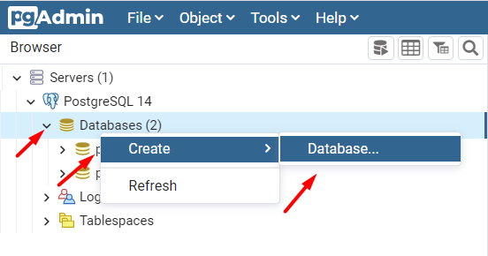
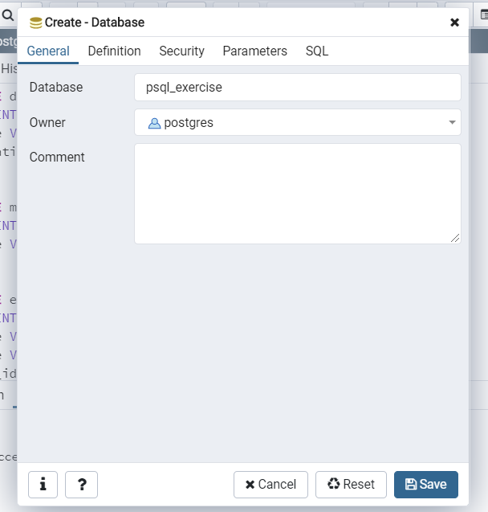
Create a New Database in pgAdmin 4
14

Slide 15
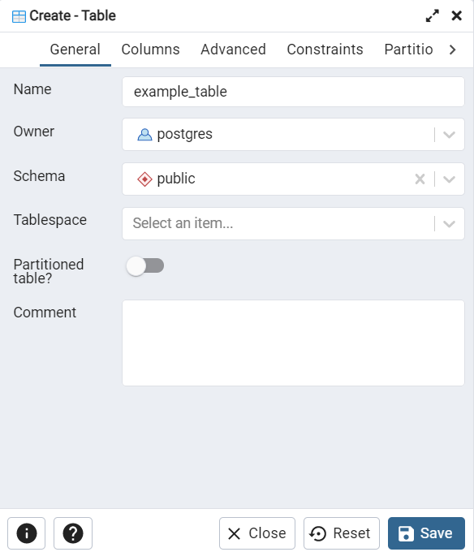
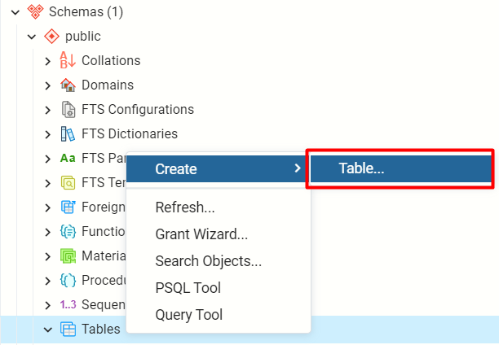
Create a New Table (1)
Right click on the Database/ Schemas/ Tables
15

Slide 16
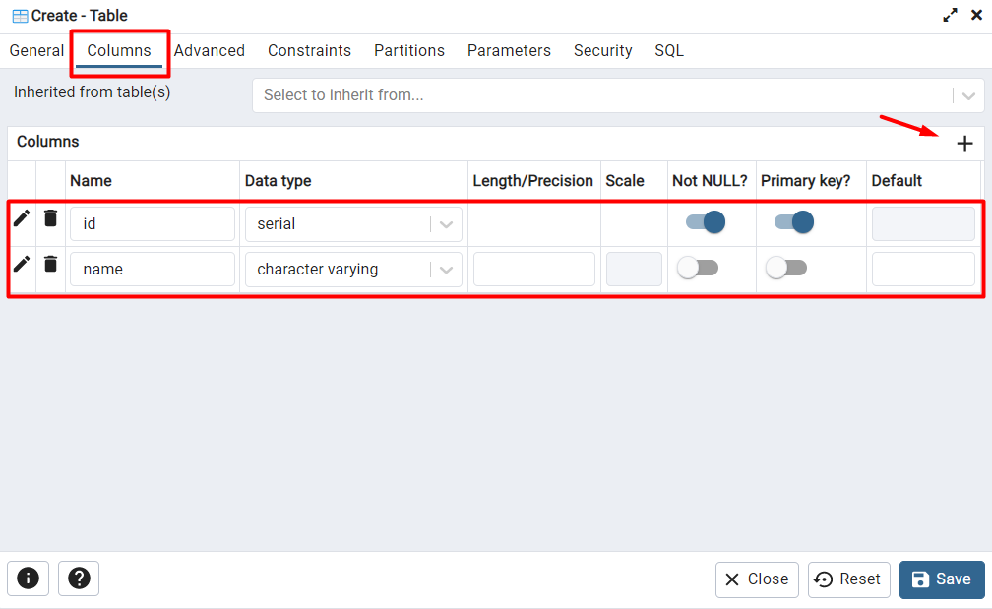
Create a New Table (2)
Create columns in the table
16

Slide 17
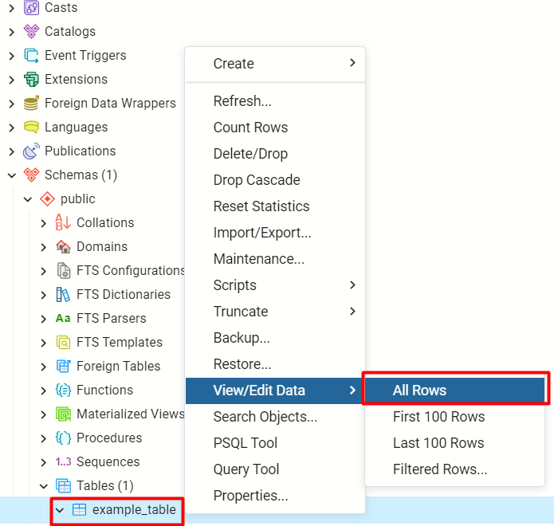
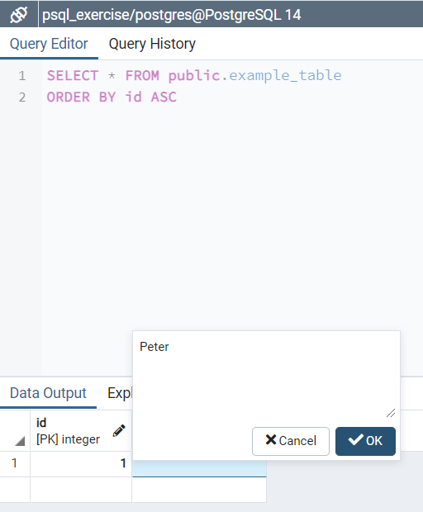
View/ Edit Data
Right click on the created table example_table
17

Slide 18

Structured Query Language

Slide 19
Structured Query Language (1)
Programming language
Designed for managing data in a relational database
Access many records with one single command
Eliminates the need to specify how to reach a record
Developed at IBM in the early 1970s

Slide 20
Structured Query Language (2)
Subdivided into several language elements
Queries
Clauses
Expressions
Predicates
Statements
Update clause
Expression
UPDATE employees
SET salary = salary * 1.1
WHERE job_title = "Cashier";
Statement
Predicate

Slide 21
SQL vs NoSQL
SQL:
Relational database management system
Predefined Schema
Suited for complex queries
Vertically scalable
NoSQL:
Non-relational database system
Dynamic Schema
Suited for hierarchical data storage
Horizontally scalable

Slide 22
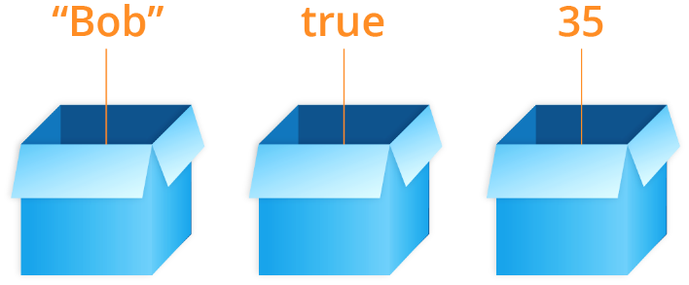
Data Types in SQL

Slide 23
String Types
CHARACTER/CHAR[(M)]
Fixed-length e.g., CHAR(30)
CHAR without the length specifier (m) is the same as CHAR(1)
CHARACTER VARYING/VARCHAR[(N)]
Variable-length with limit e.g., VARCHAR(30)
VARCHAR without (n) can store a string with unlimited length
TEXT
Stores strings of any length

Slide 24
Numeric Data Types
Integer types
SMALLINT, INTEGER/INT, BIGINT
Arbitrary Precision Numbers
DECIMAL, NUMERIC
Floating-Point Types
REAL, DOUBLE PRECISION
Serial Types
SMALLSERIAL, SERIAL, BIGSERIAL
The type INTEGER/INT is the common choice
Recommended for storing quantities where exactness is required
Storing and retrieving a value might show a slight difference
Used for creating unique identifier columns

Slide 25
Column Properties
Set no repeating values in the entire table
If a value is not specified, use the default one
Set a column that must not assume a null value
email VARCHAR (50) UNIQUE
balance DECIMAL (10,2) DEFAULT 0
name VARCHAR (100) NOT NULL

Slide 26
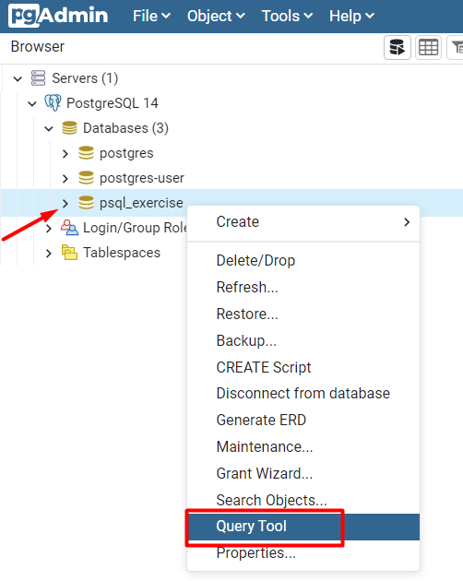
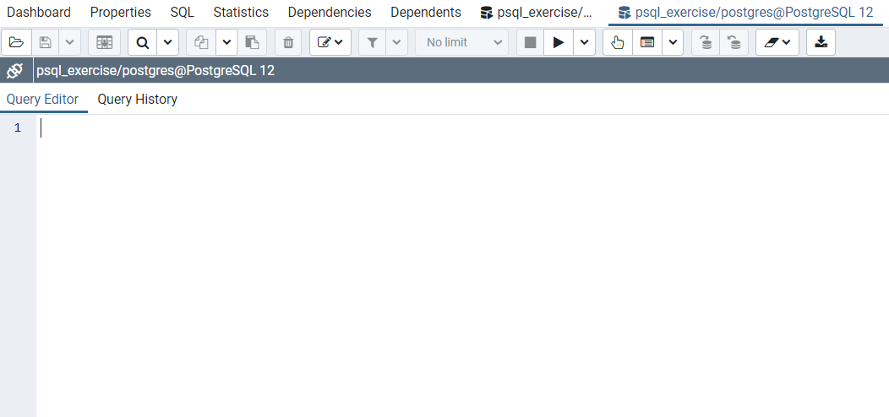
Open the Query Tool
Write SQL here

Slide 27
Create Table Using SQL
Column constraint
CREATE TABLE department (
dep_id SERIAL UNIQUE NOT NULL,
dep_name VARCHAR (100) UNIQUE NOT NULL,
dep_location VARCHAR (100) DEFAULT 'Sofia'
);
Column name
Data type

Slide 28



Table Relations
Relational Database Model in Action

Slide 29
Relationships
Relationships between tables are based on interconnections: PRIMARY KEY / FOREIGN KEY
Primary key
Foreign key
towns
Primary key
id | name | country_id
1 | Sofia | 1
2 | Varna | 1
3 | Munich | 2
4 | Berlin | 2
5 | Moscow | 3
countries
id | name
1 | Bulgaria
2 | Germany
3 | Russia
Relationships

Slide 30
Why Split Related Data?
Empty records
first | last | registered | email
David | Rivers | 05/02/2016 | drivers@mail.cx
Sarah | Thorne | 07/17/2016 | sarah@mail.cx
Michael | Walters | 11/23/2015 | walters_michael@mail.cx
email2
david@homedomain.cx
NULL
NULL
Redundant information
order_id | date | customer | product | s/n | price
00315 | 07/16/2016 | David Rivers | Oil Pump | OP147-0623 | 69.90
00315 | 07/16/2016 | David Rivers | Accessory Belt | AB544-1648 | 149.99
00316 | 07/17/2016 | Sarah Thorne | Wiper Fluid | WF000-0001 | 99.90
00317 | 07/18/2016 | Michael Walters | Oil Pump | OP147-0623 | 69.90

Slide 31
Relationships (2)
The foreign key is an identifier of a record located in another table (usually its primary key)
By using relationships, we avoid repeating data in the database
Relationships have multiplicity:
One-to-many – e.g., mountains / peaks
Many-to-many – e.g., student / course
One-to-one – e.g., example driver / car

Slide 32
One-to-One
Primary key
Primary key
Foreign key
cars
drivers
car_id | driver_id
1 | 166
2 | 102
driver_id | driver_name
166 | …
102 | …
Relation
Notes:
In One-to-One relationship each row of table Cars is related to exactly zero or one row in table Drivers. In table Cars.DriverID is a foreign key which means that there will be a relation to another table – Drivers in the case. Table Drivers has a column DriverID as well which is a primary key. The relation is always between a foreign key and a primary key. It means that all values in Cars.DriverID should be present in Drivers. DriverID except NULL. Cars.DriverID can be NULL if it is not stated otherwise.

Slide 33
One-to-Many/Many-to-One
Primary key
Primary key
Foreign key
Mountains
Peaks
mountain_id | name
1 | Caucasus
peak_id | mountain_id
61 | 1
66 | 1
Relation
Notes:
One-to-Many relationship means that each row from a table is related zero, one or many rows in the referent table. In the case above, each mountain can have 0, 1 or many peaks. The example shows that the mountain Caucasus has two peaks - One-to-Many. If you look the other way around many peaks has exactly one mountain – Many-to-One.

Slide 34
Many-to-Many
Primary key
Primary key
employees
projects
employee_id | name
1 | …
40 | …
project_id | name
4 | …
24 | …
Mapping table
employees_projects
employee_id | project_id
1 | 4
1 | 24
40 | 24
Notes:
Many-to-Many relationship relates many rows from a table to many rows in another table. For example. Employee.EmployeeID has many projects. Many projects are assigned to many employees which is the other way around. Usually we have a mapping table that takes care of the relations.

Slide 35
Junction Tables
students
classrooms
student_id | name
1 | Peter
2 | George
classroom_id | number
1 | 10
2 | 20
student_classroom
student_id | classroom_id | pk_student_classroom
1 | 1 | 11
2 | 2 | 22
1 | 2 | 12
Combination of the 2 ids

Slide 36
Connecting Tables
Set a primary key to uniquely define a record
Set a foreign key to reference the pk of another table
id BIGINT PRIMARY KEY
fk_column_name REFERENCES parent_table
fk_column_name REFERENCES parent_table (column_name)
FOREIGN KEY (first_fk, second_fk) REFERENCES other_table (first_column, second_column)

Slide 37
On Delete Option
When a record that holds a relation is removed, we have a few options:
Disallow deleting the referenced (parent) record
Delete the referenced (parent) record and all its references as well
Delete the referenced (parent) record but keep the references

Slide 38
DELETE CASCADE statement
Restrict deleting the record
Automatically delete rows referencing a deleted record
Set NULL to the foreign key columns when the referenced record is deleted
fk_column_name REFERENCES parent_table ON DELETE RESTRICT;
fk_column_name REFERENCES parent_table ON DELETE CASCADE;
fk_column_name REFERENCES parent_table ON DELETE SET NULL;

Slide 39
Example
CREATE TABLE employee (
employee_id BIGINT PRIMARY KEY,
manager_id BIGINT,
dep_id BIGINT,
name VARCHAR (100),
start_date DATE NOT NULL DEFAULT CURRENT_DATE,
manager_id REFERENCES manager ON DELETE SET NULL,
dep_id REFERENCES department ON DELETE RESTRICT
);

Slide 40
Basic SQL Commands
CREATE TABLE people (
id INT NOT NULL,
email VARCHAR NOT NULL,
first_name VARCHAR(50),
last_name VARCHAR(50)
);
Create, Read, Update, Delete

Slide 41
Create a Table Using SQL
Table name
CREATE TABLE people
(
id SERIAL PRIMARY KEY,
email VARCHAR (50) NOT NULL,
first_name VARCHAR (50),
last_name VARCHAR (50)
);

Slide 42
Inserting Data Using SQL
Values for
all columns
The SQL INSERT command
Bulk data can be recorded in a single query, separated by comma
INSERT INTO towns VALUES (33, 'Paris');
Specify
columns
INSERT INTO projects(name, start_date)
VALUES ('Reflective Jacket', NOW());
INSERT INTO employees_projects
VALUES (229, 1),
(229, 2),
(229, 3), …

Slide 43
Problems: Create and Insert
Create new Database "game_bar"
Create Tables:
employees – id, first_name, last_name
categories – id, name
products – id, name, category_id
Insert Data:
Populate the employees table with 3 test values

Slide 44
Retrieve/Read Records Using SQL
Get all information from a table
You can limit the columns and number of records
SELECT * FROM people;
* for all
Table name
SELECT first_name, last_name FROM people LIMIT 5;
List of columns
Number of records

Slide 45
Filtering the Selected Rows
You can filter rows by specific conditions using the WHERE clause
Logical and comparison operators can be used for better control
SELECT last_name, department_id
FROM employees
WHERE department_id = 1;
SELECT last_name, salary
FROM employees
WHERE salary >= 10000 AND salary <= 20000;
Notes:
In the example, the SELECT statement retrieves the name and department number of all employees whose department is 1.
Character strings and dates in the WHERE clause must be enclosed in single quotation marks (''). Number constants, however, should not be enclosed in single quotation marks.

Slide 46
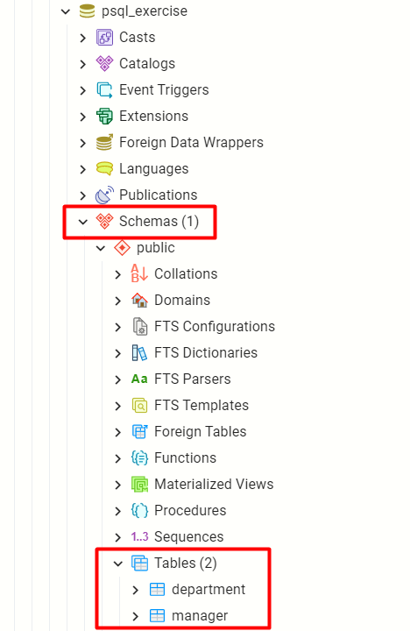
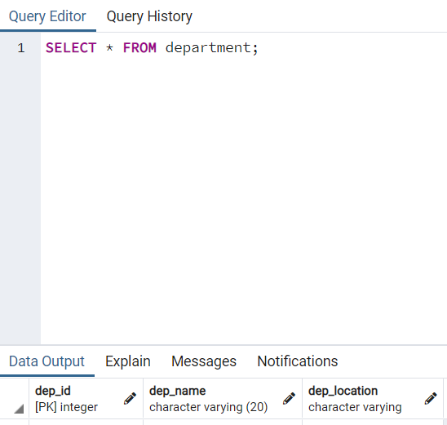
Example

Slide 47
Updating Data
The SQL UPDATE command
Note: If you left out the WHERE clause, all rows in the table would be updated
New values
UPDATE employees
SET last_name = 'Brown'
WHERE employee_id = 1;
UPDATE employees
SET salary = salary * 1.10,
job_title = CONCAT('Senior',' ', job_title)
WHERE department_id = 3;

Slide 48
Example: Update Employees Salary
Increase all employees' salaries whose job_title is "Manager" with 100
UPDATE employees
SET salary = salary + 100
WHERE job_title = 'Manager';
SELECT salary
FROM employees;

Slide 49
Altering Tables Using SQL (1)
A table can be changed using the keywords ALTER TABLE
Add new column
ALTER TABLE employees;
Table name
ALTER TABLE employees
ADD COLUMN salary DECIMAL;
Column name
Data type

Slide 50
Altering Tables Using SQL (2)
Delete existing column
Modify data type of existing column
Column name
ALTER TABLE people
DROP COLUMN full_name;
ALTER TABLE people MODIFY COLUMN email VARCHAR(100);
Column name
New data type

Slide 51
Problems: Alter Tables
Alter table
Add a new column – "middle_name" to the "employees" table
Adding Constraints
Make "category_id" foreign key linked to "id" in the "categories" table
Modifying Columns
Change the property "VARCHAR(50)" to "VARCHAR(100)" to the "middle_name" column in "employees" table

Slide 52
Dropping and Truncating
To delete all the entries in a table
To drop a table - delete data and structure
To drop entire database
TRUNCATE TABLE employees;
Table name
DROP TABLE employees;
Table name
Database name
DROP DATABASE soft_uni;

Slide 53
Example: Delete from Table
Delete all employees from the "employees" table who are in department 2 or 1
Delete Data
DELETE FROM employees
WHERE department_id = 1
OR department_id = 2;
SELECT * FROM employees
OR Condition

Slide 54

Live Demo
Writing SQL in pgAdmin 4

Slide 55

Summary
…
…
…
Data Management
Data Engine
Table Relations
Structured Query Language
PostgreSQL
Data Types
Basic SQL Queries

Slide 56
Questions?
Notes:
56

Slide 57













SoftUni Diamond Partners

Slide 58

Educational Partners

Slide 59
Trainings @ Software University (SoftUni)
Software University – High-Quality Education, Profession and Job for Software Developers
softuni.bg, softuni.org
Software University Foundation
softuni.foundation
Software University @ Facebook
facebook.com/SoftwareUniversity
Software University Forums
forum.softuni.bg
Notes:
59

Slide 60

License
This course (slides, examples, demos, exercises, homework, documents, videos, and other assets) is copyrighted content
Unauthorized copy, reproduction, or use is illegal
© SoftUni – https://softuni.org
© Software University – https://softuni.bg
Notes:
60

